Slide 1
Lesson 5
Advanced CSS Techniques

Slide 2
Agenda
CSS Pseudo-classes
CSS Pseudo-elements
Transitions
Transformations
Animations
Activity

Slide 3
Pseudo-classes

Slide 4
What are Pseudo-classes? (Article)
Keywords added to selectors that specify a special state of the selected elements
Example uses:
Style an element when a user mouses over it
Style visited and unvisited links differently
Style an element when it gets focus

Slide 5
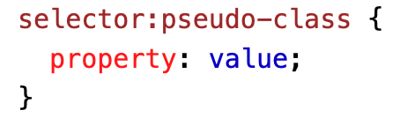
Syntax
Note the “:”

Slide 6
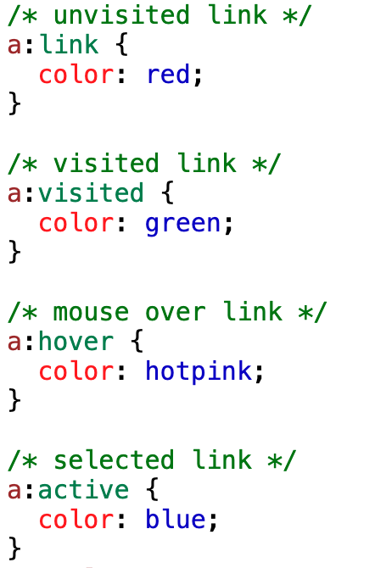
Anchor Pseudo-classes
Anchor tag = the <a> tag
What does this code do?
Has the link not been visited? Color is red
Has the link been visited? Color is green
Is user hovering over link? Color is hot pink
Is user clicking the link? Color is blue
Pseudo-classes: link, visited, hover, active

Slide 7
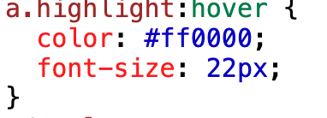
Can be combined with HTML classes!
Example:
Hover pseudo-class can be used with <div>!

Slide 8
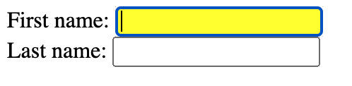
:focus
Select and style an element (e.g. input field) when it gets focus, ex.

Slide 9
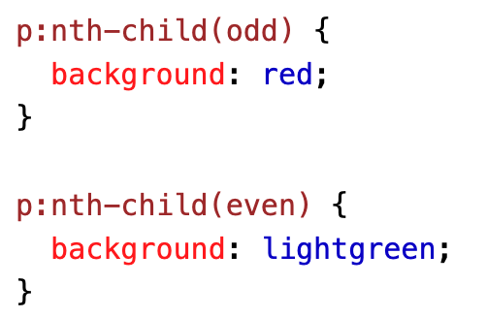
:nth-child()
Matches every element that is the nth child of its parent. Example
n can be a number, a keyword (odd or even), or a formula (like an + b).
n can also be even or odd: (the index of the first child is 1)
Or for a multiple of some number: example

Slide 10
Pseudo-elements

Slide 11
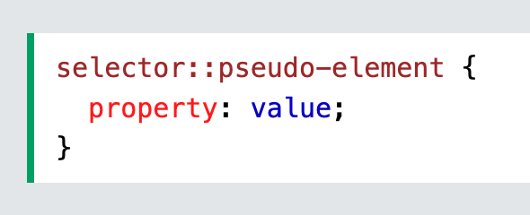
What are pseudo-elements?
used to style specified parts of an element
Style the first letter, or line, of an element
Insert content before, or after, the content of an element
Syntax:

Slide 12
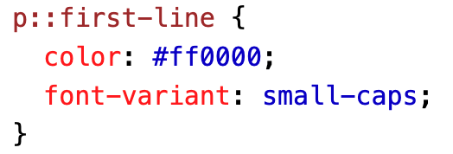
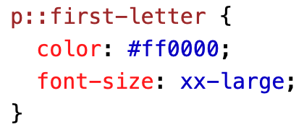
::first-line
::first-letter
add a special style to the first line of a text
Only for block elements
font properties
color properties
background properties
word-spacing
letter-spacing
text-decoration
vertical-align
text-transform
line-height
Clear
Example
add a special style to the first letter of a text
Only block elements
font properties
color properties
background properties
margin properties
padding properties
border properties
text-decoration
vertical-align (only if "float" is "none")
text-transform
line-height
float
clear
Example

Slide 13
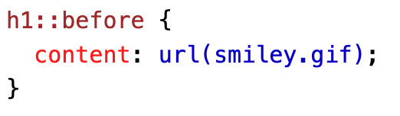
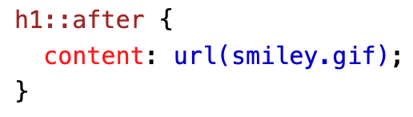
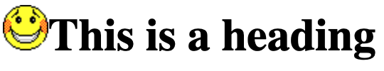

::before
::after
insert some content before the content of an element (example)
Insert some content after the content of an element (example)

Slide 14
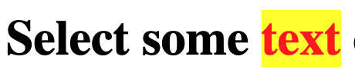
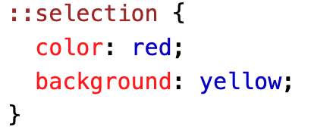
::selection
matches the portion of an element that is selected by a user
Properties to be applied:
Color
Background
Cursor
Outline

Slide 15
Exercise
Copy this html:
<!DOCTYPE html>
<html>
<head>
<title>Pseudo-Classes and Pseudo-Elements</title>
</head>
<body>
<ul class="styled-list">
<li>Item 1</li>
<li>Item 2</li>
<li>Item 3</li>
<li>Item 4</li>
<li>Item 5</li>
</ul>
</body>
</html>
Let’s try to:
Make list items light gray when hovered
Make the • red (using ::before)
Make every odd list item have the color #f0f0f0
Notes:
content: "• "; color: red;

Slide 16
Solution
/* Pseudo-Classes */
.styled-list li:hover {
background-color: lightgrey;
}
/* Pseudo-Elements */
.styled-list li::before {
content: "• ";
color: red;
}
.styled-list li:nth-child(odd) {
background-color: #f0f0f0;
}
Notes:
screenshot

Slide 17
Transitions

Slide 18
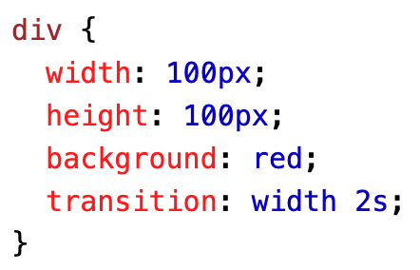
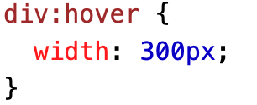
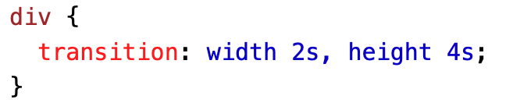
Transitions
Change property values smoothly, over a given duration.
Usage:
Specify which CSS properties should be animated.
Define the duration of the animation.
The <div> element has specified a transition effect for the width property, with a duration of 2 seconds.
Example
You can add more than 1 property

Slide 19
Speed Curve of Transition
The transition-timing-function property specifies the speed curve of the transition effect.
ease - specifies a transition effect with a slow start, then fast, then end slowly (this is default)
linear - specifies a transition effect with the same speed from start to end
ease-in - specifies a transition effect with a slow start
ease-out - specifies a transition effect with a slow end
ease-in-out - specifies a transition effect with a slow start and end
cubic-bezier(n,n,n,n) - lets you define your own values in a cubic-bezier function

Slide 20
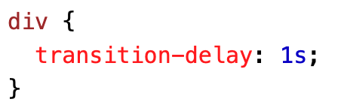
Transition-delay
The transition-delay property specifies a delay (in seconds) for the transition effect.
The following example has a 1 second delay before starting: example

Slide 21
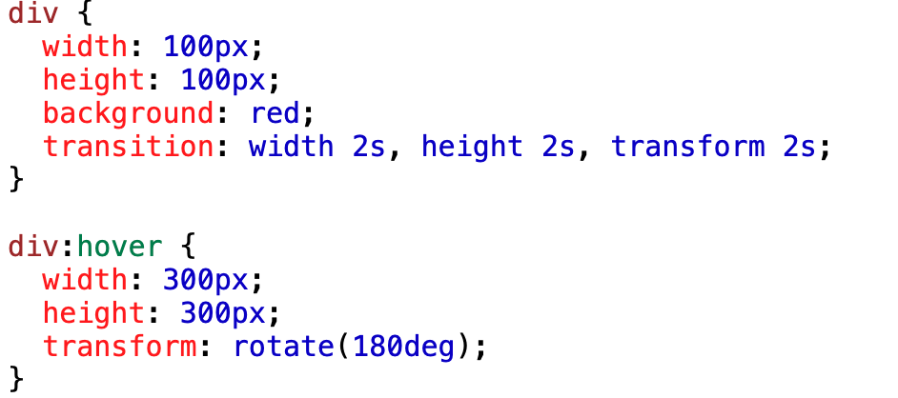
Transition + Transformation

Slide 22
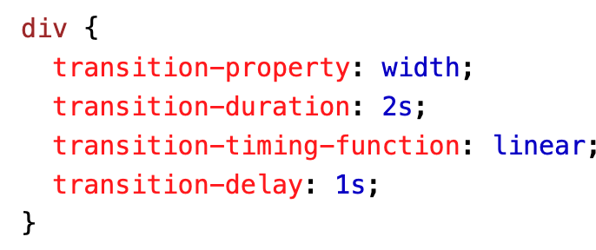
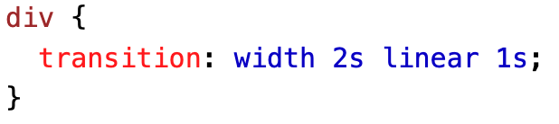
Transition property shorthand

Slide 23
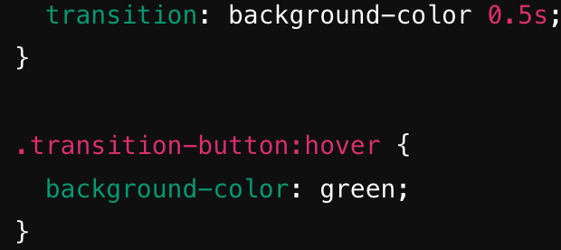
Exercise
Copy HTML Now let’s make the button turn green on hover
<!DOCTYPE html>
<html>
<style>
button {
background-color: blue;
color: white;
padding: 10px 20px;
border: none;
cursor: pointer;
}
<head>
<title>CSS Transitions</title>
</head>
<body>
<button>Hover Me!</button>
</body>
</html>

Slide 24
Transformations

Slide 25
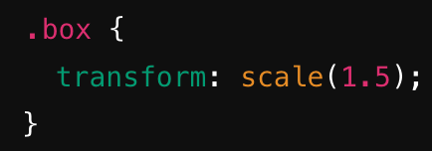
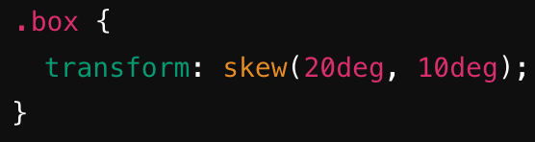
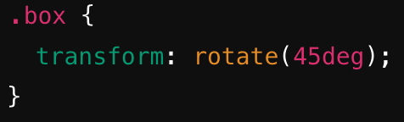
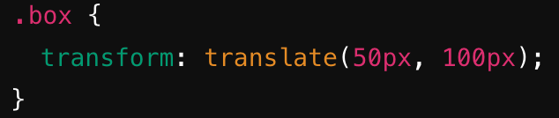
Transforms
allow you to change the shape, size, and position of an element
Common transforms:
scale() changes size of element
rotate() rotates an element
translate() moves an element
skew() skews an element

Slide 26
Animations

Slide 27
Animations
lets an element gradually change from one style to another.
You can change as many CSS properties you want, as many times as you want.
You need keyframes: Keyframes hold what styles the element will have at certain times.

Slide 28
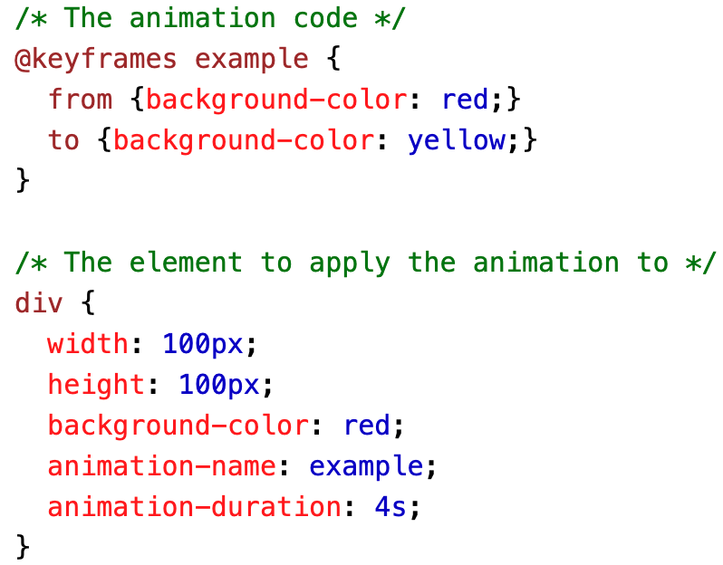
@keyframes
@keyframes rule allows the animation to gradually change from the current style to the new style at certain times.
Must bind animation to an element
The following example binds the "example" animation to the <div> element. The animation will last for 4 seconds, and it will gradually change the background-color of the <div> element from "red" to "yellow":

Slide 29
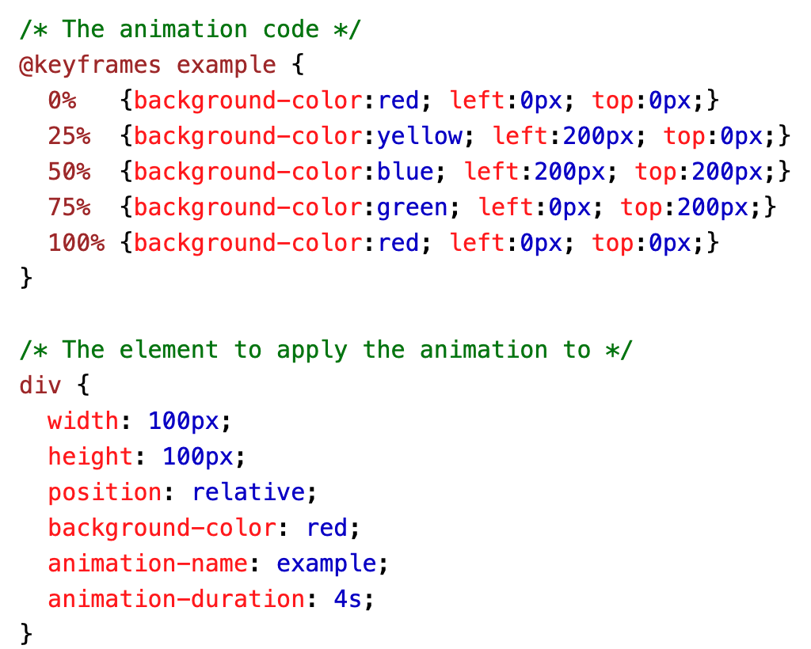
animation-duration
how long an animation should take to complete
Not specified? No animation. (default is 0s)
If you use %, you can add as many style changes as you want

Slide 30
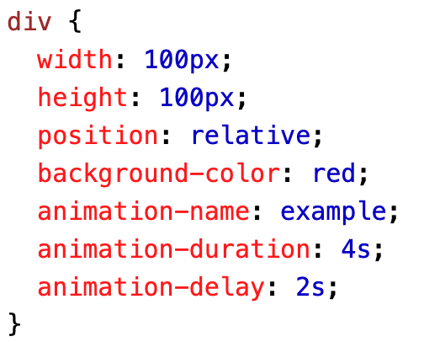
animation-delay
The animation-delay property specifies a delay for the start of an animation.
The following example has a 2 seconds delay before starting the animation:

Slide 31
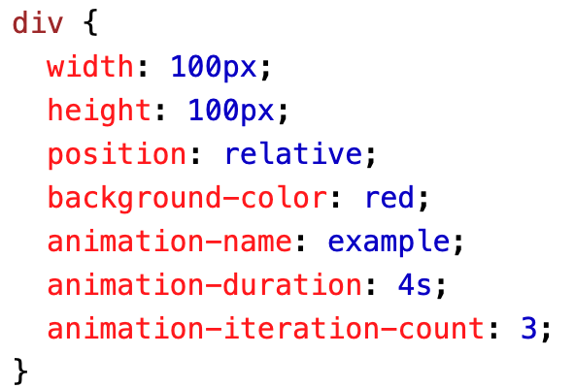
animation-iteration-count
How many times an animation should run (the value can be infinite as well)

Slide 32
Animation speed curve
specifies the speed curve of the animation.
ease - Specifies an animation with a slow start, then fast, then end slowly (this is default)
linear - Specifies an animation with the same speed from start to end
ease-in - Specifies an animation with a slow start
ease-out - Specifies an animation with a slow end
ease-in-out - Specifies an animation with a slow start and end
cubic-bezier(n,n,n,n) - Lets you define your own values in a cubic-bezier function

Slide 33
Animation-fill-mode (example, example, example)
specifies a style for the target element when the animation is not playing (before it starts, after it ends, or both)
none - Default value. Animation will not apply any styles to the element before or after it is executing
forwards - The element will retain the style values that is set by the last keyframe (depends on animation-direction and animation-iteration-count)
backwards - The element will get the style values that is set by the first keyframe (depends on animation-direction), and retain this during the animation-delay period
both - The animation will follow the rules for both forwards and backwards, extending the animation properties in both directions
Notes:
CSS animations do not affect an element before the first keyframe is played or after the last keyframe is played. The animation-fill-mode property can override this behavior.

Slide 34
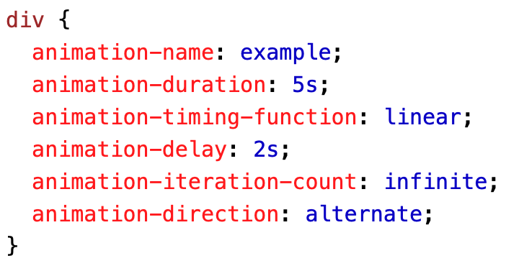
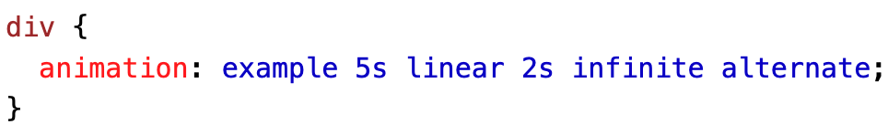
Animation Shorthand

Slide 35
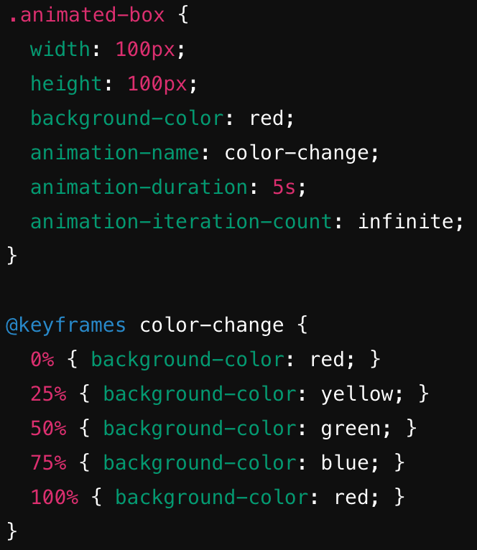
Exercise (change div color with keyframes)
Copy HTML
<!DOCTYPE html>
<html>
<head>
<title>CSS Animations</title>
</head>
<body>
<div class="animated-box">Animated!</div>
</body>
</html>
CSS Solution →

Slide 36
Activity

Slide 37
Adding advanced CSS to your All About Me page
Style the link you have in the all about me page with anchor pseudo-classes
Put a Submit button after the questions in the Quiz section that changes color when you hover over it (syntax: <button>This is a button</button> )
Use a pseudo-element at least once
Use a transition at least once
Use an animation at least once
Extra credit:
For pseudo classes, pseudo elements, transitions and animations, for every additional one that you add, you will get 1 extra credit point.

Slide 38
Thanks and Happy Hacking!

